Slide 1
CSO-Recitation 15 CSCI-UA 0201-007
R15: Assessment 13 & Mock Exam

Slide 2
Today’s Topics
Mock Exam
Assessment 13
Review pipelined CPU

Slide 3
Mock Exam

Slide 4
1 Basic C and X86 64 machine instructions (28 points)

Slide 5
1-A
Given a binary sequence (00000110)2, what is its decimal value?
6
5
8
10
None of the above
(00000110)2
= 1 * 2^2 + 1 * 2^1
= 6

Slide 6
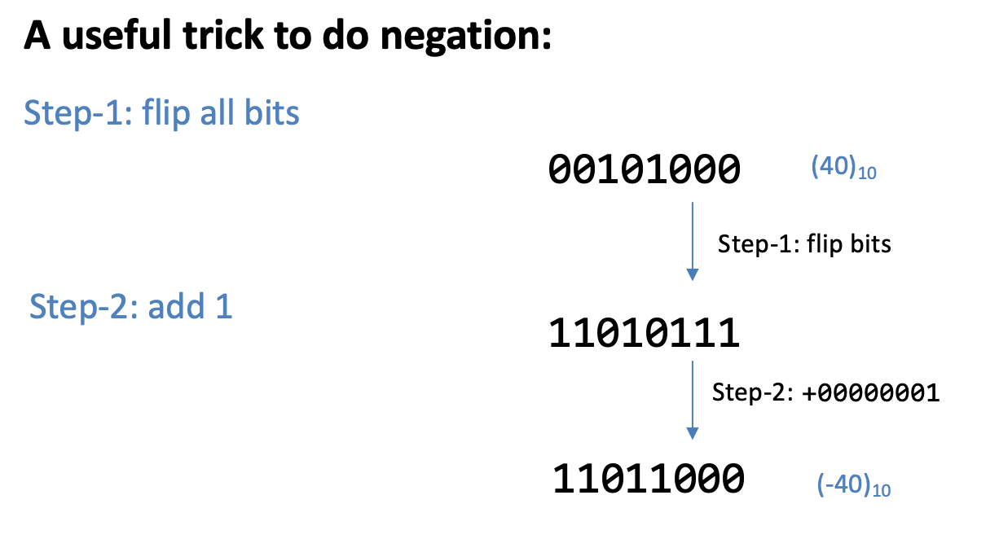
1-B
Given a signed char −20, what is its binary representation?
(1001 0100)2
(1110 1011)2
(1110 1100)2
(0001 0100)2
None of the above
20 = (0001 0100)2
(0001 0100)2 flip=> (1110 1011)2
(1110 1011)2 + 1 = (1110 1100)2

Slide 7
1-C
Suppose %eax contains signed int 255. After successfully executing movl %eax, (%ecx), what is the byte value stored at the address given by %ecx?
0xff
0x00
0xf0
0x0f
None of the above
(0001 0100)2 flip=> (1110 1011)2
%eax & movl: 4 bytes
255 => 0x00 00 00 ff
%ecx

Slide 8
1-C
Suppose %eax contains signed int 255. After successfully executing movl %eax, (%ecx), what is the byte value stored at the address given by %ecx?
0xff
0x00
0xf0
0x0f
None of the above
(0001 0100)2 flip=> (1110 1011)2
%eax & movl: 4 bytes
255 => 0x00 00 00 ff
%ecx
ff
00
00
00
Lower address
Higher
address

Slide 9
1-C
Suppose %eax contains signed int 255. After successfully executing movl %eax, (%ecx), what is the byte value stored at the address given by %ecx?
0xff
0x00
0xf0
0x0f
None of the above
(0001 0100)2 flip=> (1110 1011)2
%eax & movl: 4 bytes
255 => 0x00 00 00 ff
Q: what is the answer if the machine is Big Endian?
%ecx
ff
00
00
00
Lower address
Higher
address

Slide 10
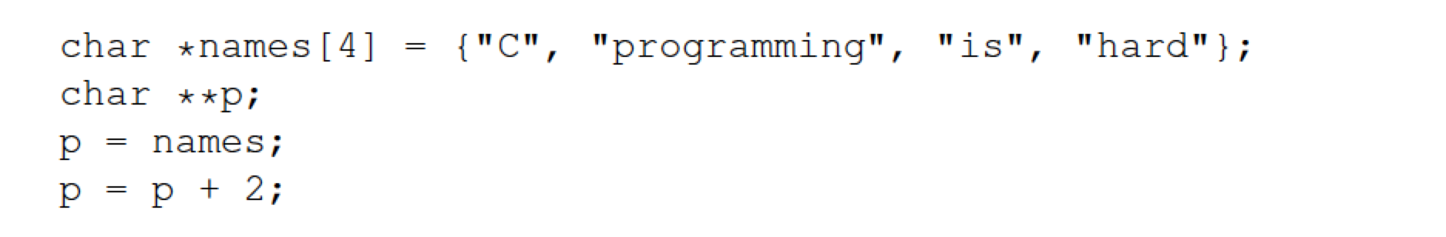
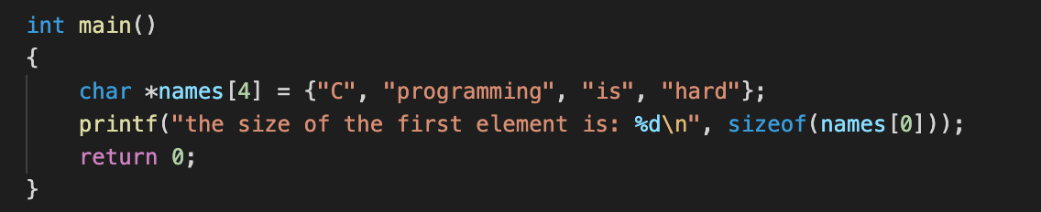
1-D
Consider the following code snippet,
After executing the above, what is the value of p[1][1]?
name: an array of char pointers
(0001 0100)2 flip=> (1110 1011)2
Q1: what is the size of name[0]?
ff
00
00
00

Slide 11
1-D
Consider the following code snippet,
After executing the above, what is the value of p[1][1]?
name: an array of char pointers
(0001 0100)2 flip=> (1110 1011)2
addr 1
The name of an array ⬄ a pointer
‘C’ | \0
names
Each element: a pointer to
(address of) a string
00
00
addr 1
addr 2
addr 3
addr 4
0
8
16
24

Slide 12
1-D
Consider the following code snippet,
After executing the above, what is the value of p[1][1]?
(0001 0100)2 flip=> (1110 1011)2
addr 1
‘C’ | \0
p, names
00
00
addr 1
addr 2
addr 3
addr 4
0
8
16
24

Slide 13
1-D
Consider the following code snippet,
After executing the above, what is the value of p[1][1]?
Pointer arithmetic.
(0001 0100)2 flip=> (1110 1011)2
addr 1
‘C’ | \0
p, names
00
00
addr 1
addr 2
addr 3
addr 4
0
8
16
24

Slide 14
1-D
Consider the following code snippet,
After executing the above, what is the value of p[1][1]?
Pointer arithmetic.
(0001 0100)2 flip=> (1110 1011)2
p: a pointer to char *
Pointer arithmetic: value of (p+2) = value of p + 2 * sizeof(char *)
char * type: pointer to a char => 8 bytes
value of (p+2) = value of p + 16
ff
00
00
00

Slide 15
1-D
Consider the following code snippet,
After executing the above, what is the value of p[1][1]?
(0001 0100)2 flip=> (1110 1011)2
addr 1
‘C’ | \0
names
The name of an array ⬄ a pointer
p[1] = *(p + 1)
p
00
00
addr 1
addr 2
addr 3
addr 4
0
8
16
24
p[1] = *(p+1) = addr4
p + 1

Slide 16
1-D
Consider the following code snippet,
After executing the above, what is the value of p[1][1]?
(0001 0100)2 flip=> (1110 1011)2
addr 1
‘C’ | \0
addr 4
names
p
addr 4 + 1
p[1][1] = addr4[1]
=*(addr4+1)
00
00
‘h’ | ‘a’ | ‘r’ | ‘d’ | \0
addr 1
addr 2
addr 3
addr 4
0
8
16
24
p[1] = *(p+1) = addr4
p + 1

Slide 17
1-D
Consider the following code snippet,
After executing the above, what is the value of p[1][1]?
(0001 0100)2 flip=> (1110 1011)2
‘a’
00
00

Slide 18
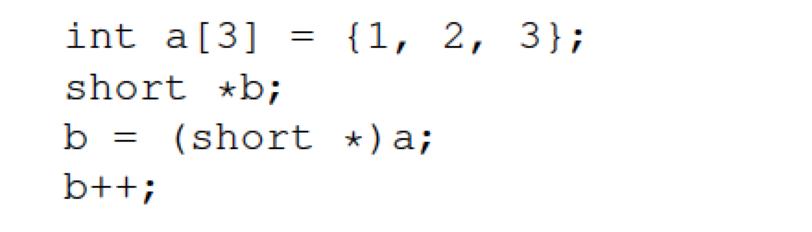
1-E
Consider the following code snippet,
After executing the above, what is the value of *b?
(0001 0100)2 flip=> (1110 1011)2
Size of int: 4 bytes
Size of short: 2 bytes

Slide 19
1-E
Consider the following code snippet,
After executing the above, what is the value of *b?
(0001 0100)2 flip=> (1110 1011)2
a[0] = 1
a
Little endian
00
00
00
01
00
00
02
00
00
03
00
00
0
4
8

Slide 20
1-E
Consider the following code snippet,
After executing the above, what is the value of *b?
(0001 0100)2 flip=> (1110 1011)2
b, a
00
00
00
01
00
00
02
00
00
03
00
00
0
4
8

Slide 21
1-E
Consider the following code snippet,
After executing the above, what is the value of *b?
Pointer arithmetic.
(0001 0100)2 flip=> (1110 1011)2
b: a pointer to short
Pointer arithmetic: value of (b+1) = value of b + 1 * sizeof(short)
short type: 2 bytes
value of (b+1) = value of b + 2
ff
00
00

Slide 22
1-E
Consider the following code snippet,
After executing the above, what is the value of *b?
Pointer arithmetic.
(0001 0100)2 flip=> (1110 1011)2
*b will fetch 2 bytes
Since b is a pointer to short
sizeof(short) = 2 bytes
a
b
00
00
00
01
00
00
02
00
00
03
00
00
0
2
4
8

Slide 23
1-E
Consider the following code snippet,
After executing the above, what is the value of *b?
Pointer arithmetic.
(0001 0100)2 flip=> (1110 1011)2
a
b
*b = 0x00 00
00
00
00
01
00
00
02
00
00
03
00
00
0
2
4
8

Slide 24
1-E
Consider the following code snippet,
After executing the above, what is the value of *b?
(0001 0100)2 flip=> (1110 1011)2
0

Slide 25
1-F
Which following expressions compute the remainder of x modulo 64 (x is of type unsigned int)?
x % 64
x / 64
x >> 6
x & 0x0000003f
(x << 26) >> 26
None of the above
x = i * 64 + j, 0<= j < 64
x: 32bits, 64 = 2^6
(0001 0100)2 flip=> (1110 1011)2
26 bits | 6 bits
0x3F: 00111111
Result: (111111)2
i
j
26 bits | 111111
00
111111000000… | 000000
000000….. | 111111

Slide 26
1-G
First try to search in the current heap to see whether there is an available free chunk.
Which of the following statements are true w.r.t. malloc?
Every call to malloc results in the memory allocator making a syscall (e.g. sbrk) to request memory from OS.
malloc returns failure if and only if the memory allocator does not have any free chunks.
When using the implicit-list design, malloc tends to traverse more chunks than when using the explicit-list design.
None of the above.
If there is no free chunks, it will make a syscall (sbrk) to ask for more space in the heap.
Implicit-list: potentially traverse all chunks (both free and allocated)
Explicit-list: only traverse free chunks.
00

Slide 27
2 Memory hierarchy (25 points + bonus 10 points)

Slide 28
2-A
What is the latency to access L1 cache and main memory, respectively? Do not forget to write down the time unit. (We consider the answer correct if it’s within a factor of 10)
L1 cache: SRAM 0.5-2.5ns
Main memory: DRAM 50-70ns
00

Slide 29
2-B
The rest of the questions assume a cache whose total size is 1KB and each cache line/block is 64-byte.
How many cacheline/blocks does the cache contain?
(total size)/(size of each line) = 1KB/64 bytes = 16
00

Slide 30
2-C
The rest of the questions assume a cache whose total size is 1KB and each cache line/block is 64-byte.
Suppose the cache is a direct mapped cache. Given a 32-bit address 0xab345f78, which cacheline/block contains the cached data for this address?
1 cacheline per set
16 cachelines => 16 sets
Used to index which byte within a specific cacheline.
2^(# of bits) = how many bytes in total in a cacheline
00
Tag | index | Byte offset
# of bits = log2(64) = 6

Slide 31
2-C
The rest of the questions assume a cache whose total size is 1KB and each cache line/block is 64-byte.
Suppose the cache is a direct mapped cache. Given a 32-bit address 0xab345f78, which cacheline/block contains the cached data for this address?
1 cacheline per set
16 cachelines => 16 sets
Used to index which set caches this data.
2^(# of bits) = how many sets in total
00
Tag | index | Byte offset
# of bits = log2(16) = 4
# of bits = log2(64) = 6

Slide 32
2-C
The rest of the questions assume a cache whose total size is 1KB and each cache line/block is 64-byte.
Suppose the cache is a direct mapped cache. Given a 32-bit address 0xab345f78, which cacheline/block contains the cached data for this address?
1 cacheline per set
16 cachelines => 16 sets
Used to distinguish different addresses which are mapped to the same set.
# of bits = total bits – index - byte offset
00
Tag | index | Byte offset
# of bits = 32 – 4 – 6 = 22
# of bits = log2(16) = 4
# of bits = log2(64) = 6

Slide 33
2-C
The rest of the questions assume a cache whose total size is 1KB and each cache line/block is 64-byte.
Suppose the cache is a direct mapped cache. Given a 32-bit address 0xab345f78, which cacheline/block contains the cached data for this address?
13
0xab345f78:
00
Tag | index | Byte offset
1101
111000
# of bits = 32 – 4 – 6 = 22
# of bits = log2(16) = 4
# of bits = log2(64) = 6

Slide 34
2-C
Suppose we want to read the byte value in this address.
0xab345f78:
Tag (t) |  | Byte offset
1101
111000
Sets/Cachelines:
(111000)2 = 56
57th bytes in data
0
1
2
…
13
…
15
Valid | Tag | Data (64 bytes)
Y
t
00
64 bytes of data, index 0 - 63
can be represented by 6 bits (000000 – 111111)
=> The size of byte offset part
16 sets, index 0 - 15
can be represented by 4 bits (0000 – 1111)
=> The size of index part

Slide 35
2-D
How many cacheline-aligned memory addresses can
be mapped to the same cache location as 0xab345f78
(assuming 32-bit address space)?
2^22
0xab345f78:
Tag | index | Byte offset
1101
Can be arbitrary value.
Addresses which satisfies:
00
Tag | index | Byte offset
1101
000000
# of bits = 32 – 4 – 6 = 22
# of bits = log2(16) = 4
# of bits = log2(64) = 6

Slide 36
2-D: exercise
How many cacheline-aligned memory addresses can
be mapped to the same cache location as 0xab345f78
(assuming 32-bit address space)?
2^28
0xab345f78:
Tag | index | Byte offset
1101
Can be arbitrary value.
Can be arbitrary value.
Addresses which satisfies:
00
Tag | index | Byte offset
1101
# of bits = 32 – 4 – 6 = 22
# of bits = log2(16) = 4
# of bits = log2(64) = 6

Slide 37
2-E
If your answer in D. is bigger than 1, how can we determine which of the memory addresses is actually stored at a given cache location?
Compare the tag.
00
Tag | index | Byte offset

Slide 38
2-F
Suppose the cache is a 2-way associative cache, i.e. the cache is organized into sets each of which contains 2 cachelines. How many sets does the cache contain?
# of cachelines = 16 (Q2-A)
# of sets = # of cachelines / # of cachelines per set = 16/2 = 8
00

Slide 39
2-G
For the 2-way assocative cache, given a 32-bit address 0xab345f78, which set may contain the cached data for this address?
5
0xab345f78:
Tag | index | Byte offset
101
111000
# of bits =
total number of bits
- index – byte offset
= 32 – 3 – 6 = 23
# of bits =
log2(# of sets)
= log2(8) = 3
# of bits =
log2(# of bytes per cacheline)
= log2(64) = 6
00

Slide 40
2-H
For the 2-way associactive cache, how many cacheline-aligned memory addresses can be mapped to the same set as 0xab345f78
2^23
0xab345f78:
Tag | index | Byte offset
101
Can be arbitrary value.
Addresses which satisfies:
00
Tag | index | Byte offset
101
000000
# of bits = 32 – 3 – 6 = 23
# of bits = log2(8) = 3
# of bits = log2(64) = 6

Slide 41
2-I (bonus)
Suppose ROWS=16, COLS=16. Out of ROWS*COLS total 8-byte memory accesses, how many of them result in cache miss (assuming the cache is direct-mapped and it’s empty before the start of the loop)?
Note: Here we suppose the start address of this array is cacheline-aligned.
16
columns
 |  | …
…
8 bytes
00
16 rows
Memory address

Slide 42
2-I (bonus)
Suppose ROWS=16, COLS=16. Out of ROWS*COLS total 8-byte memory accesses, how many of them result in cache miss (assuming the cache is direct-mapped and it’s empty before the start of the loop)?
Note: Here we suppose the start address of this array is cacheline-aligned.
Access this
16
columns
 |  | …
…
Cache miss!
Add into cache.
00
16 rows
Access sequence

Slide 43
2-I (bonus)
Suppose ROWS=16, COLS=16. Out of ROWS*COLS total 8-byte memory accesses, how many of them result in cache miss (assuming the cache is direct-mapped and it’s empty before the start of the loop)?
Note: Here we suppose the start address of this array is cacheline-aligned.
16
columns
 |  | …
…
Cache hit!
00
16 rows
Access sequence

Slide 44
2-I (bonus)
Suppose ROWS=16, COLS=16. Out of ROWS*COLS total 8-byte memory accesses, how many of them result in cache miss (assuming the cache is direct-mapped and it’s empty before the start of the loop)?
Note: Here we suppose the start address of this array is cacheline-aligned.
64 bytes = 8 * sizeof(long)
16
columns
 |  | …
…
First access: cache miss.
Add 64 bytes into cacheline.
Therefore the following 7 accesses are cache hit.
00
16 rows
Access sequence

Slide 45
2-I (bonus)
Suppose ROWS=16, COLS=16. Out of ROWS*COLS total 8-byte memory accesses, how many of them result in cache miss (assuming the cache is direct-mapped and it’s empty before the start of the loop)?
Note: Here we suppose the start address of this array is cacheline-aligned.
16
columns
 |  | …
…
Same to the following accesses.
Cache miss rate = 1/8
Cache miss times = 16 * 16 * 1/8 = 32
00
16 rows
Access sequence

Slide 46
2-J (bonus)
Suppose ROWS=16, COLS=16. Out of ROWS*COLS total 8-byte memory accesses, how many of them result in cache miss (assuming the cache is direct-mapped and it’s empty before the start of the loop)?
Note: Here we suppose the start address of this array is cacheline-aligned.
Start 1st column
16
columns
 |  | …
…
Cache miss!
Add into cache.
00
16 rows
Access sequence

Slide 47
2-J (bonus)
Suppose ROWS=16, COLS=16. Out of ROWS*COLS total 8-byte memory accesses, how many of them result in cache miss (assuming the cache is direct-mapped and it’s empty before the start of the loop)?
Note: Here we suppose the start address of this array is cacheline-aligned.
16
columns
 |  | …
…
Cache miss!
Add into cache.
00
16 rows
Access sequence

Slide 48
2-J (bonus)
Suppose ROWS=16, COLS=16. Out of ROWS*COLS total 8-byte memory accesses, how many of them result in cache miss (assuming the cache is direct-mapped and it’s empty before the start of the loop)?
Note: Here we suppose the start address of this array is cacheline-aligned.
16
columns
 |  | …
…
Cache miss!
Add into cache.
00
16 rows
Access sequence

Slide 49
2-J (bonus)
Suppose ROWS=16, COLS=16. Out of ROWS*COLS total 8-byte memory accesses, how many of them result in cache miss (assuming the cache is direct-mapped and it’s empty before the start of the loop)?
Note: Here we suppose the start address of this array is cacheline-aligned.
16
columns
 |  | …
…
Cache hit!
Is this correct?
No!
00
16 rows
Access sequence

Slide 50
2-J (bonus)
Suppose ROWS=16, COLS=16. Out of ROWS*COLS total 8-byte memory accesses, how many of them result in cache miss (assuming the cache is direct-mapped and it’s empty before the start of the loop)?
Note: Here we suppose the start address of this array is cacheline-aligned.
16
columns
 |  | …
…
Cache hit!
00
16 rows
Access sequence

Slide 51
2-J (bonus)
Suppose ROWS=16, COLS=16. Out of ROWS*COLS total 8-byte memory accesses, how many of them result in cache miss (assuming the cache is direct-mapped and it’s empty before the start of the loop)?
Note: Here we suppose the start address of this array is cacheline-aligned.
16
columns
 |  | …
…
Cache hit!
00
16 rows
Access sequence

Slide 52
2-J (bonus)
Suppose ROWS=16, COLS=16. Out of ROWS*COLS total 8-byte memory accesses, how many of them result in cache miss (assuming the cache is direct-mapped and it’s empty before the start of the loop)?
Note: Here we suppose the start address of this array is cacheline-aligned.
64 bytes
= 8 * sizeof(long)
= 8 columns
16
columns
 |  | …
…
First column: cache miss.
The following 7 columns: cache hit.
Cache miss rate = 1/8
Cache miss times = 16 * 16 * 1/8 = 32
Is this correct?
No!
00
16 rows
Access sequence

Slide 53
cacheline size
Which set should it be mapped to?
Direct mapped: one cacheline per set
# number of sets/cachelines in the cache: 16 (Q2-B)
Index: 0000 – 1111 (0 – 15)
Each row = 16 * sizeof(long) = 2 cacheline size
16 rows

Slide 54
cacheline size
Set: 0
Suppose the start address is 0.
Direct mapped: one cacheline per set
# number of sets/cachelines in the cache: 16 (Q2-B)
Index: 0000 – 1111 (0 – 15)
Each row = 16 * sizeof(long) = 2 cacheline size
16 rows
Address: 0
Tag (22 bits) | Index (4 bits) | Byte offset (6 bits)
0000

Slide 55
cacheline size
Set: 0
Set: 1
The start address is
0 + 64 (cacheline size).
Direct mapped: one cacheline per set
# number of sets/cachelines in the cache: 16 (Q2-B)
Index: 0000 – 1111 (0 – 15)
Each row = 16 * sizeof(long) = 2 cacheline size
16 rows
Address: 64 = 1 * 2^6
Tag (22 bits) | Index (4 bits) | Byte offset (6 bits)
0001

Slide 56
cacheline size
Set: 0
Set: 1
Set: 2
The start address is
0 + 2 *64 (cacheline size).
Direct mapped: one cacheline per set
# number of sets/cachelines in the cache: 16 (Q2-B)
Index: 0000 – 1111 (0 – 15)
Each row = 16 * sizeof(long) = 2 cacheline size
16 rows
Address: 64 = 2 * 2^6
Tag (22 bits) | Index (4 bits) | Byte offset (6 bits)
0010

Slide 57
cacheline size
Set: 0
Set: 1
Set: 2
Set: 3
Set: 4
Set: 5
Direct mapped: one cacheline per set
# number of sets/cachelines in the cache: 16 (Q2-B)
Index: 0000 – 1111 (0 – 15)
Set: 6
Set: 7
Set: 8
Set: 9
The last set in cache.
Set: 10
Set: 11
Set: 12
Set: 13
Each row = 16 * sizeof(long) = 2 cacheline size
Set: 14
Set: 15
16 rows
Tag (22 bits) | Index (4 bits) | Byte offset (6 bits)

Slide 58
cacheline size
Set: 0
Set: 1
Set: 2
Set: 3
Set: 4
Set: 5
Direct mapped: one cacheline per set
# number of sets/cachelines in the cache: 16 (Q2-B)
Index: 0000 – 1111 (0 – 15)
Set: 6
Set: 7
Set: 8
Set: 9
Set: 10
Set: 11
Rounded to set 0.
Each row = 16 * sizeof(long) = 2 cacheline size
Set: 12
Set: 13
Set: 14
Set: 15
16 rows
Address: 64 = 16 * 2^6
Set: 0
The start address is
0 + 16 *64 (cacheline size).
Tag (22 bits) | Index (4 bits) | Byte offset (6 bits)
0000

Slide 59
cacheline size
Set: 0
Set: 1
Set: 2
Set: 3
Set: 4
Set: 5
Direct mapped: one cacheline per set
# number of sets/cachelines in the cache: 16 (Q2-B)
Index: 0000 – 1111 (0 – 15)
Set: 6
Set: 7
Set: 8
Set: 9
Set: 10
Set: 11
Set: 12
Set: 13
Each row = 16 * sizeof(long) = 2 cacheline size
Set: 14
Set: 15
16 rows
Set: 0
Set: 1
Set: 2
Set: 3
Tag (22 bits) | Index (4 bits) | Byte offset (6 bits)
Set: 4
Set: 5
Set: 6
Set: 7
Set: 8
Set: 9
Set: 10
Set: 11
Set: 12
Set: 13
Set: 14
Set: 15

Slide 60
cacheline size
Set: 0
Set: 1
Set: 2
Set: 3
Set: 4
Set: 5
Direct mapped: one cacheline per set
# number of sets/cachelines in the cache: 16 (Q2-B)
Index: 0000 – 1111 (0 – 15)
Set: 6
Set: 7
Set: 8
Set: 9
Set: 10
Set: 11
Set: 12
Set: 13
Each row = 16 * sizeof(long) = 2 cacheline size
Set: 14
Set: 15
16 rows
Set: 0
Set: 1
Set: 2
Set: 3
Set: 4
Set: 5
Set: 6
Set: 7
Set: 8
Set: 9
Set: 10
Set: 11
Set: 12
Set: 13
Set: 14
Set: 15

Slide 61
cacheline size
Set: 0
Set: 1
Set: 2
Set: 3
Start 1st column
Set: 4
Set: 5
Direct mapped: one cacheline per set
# number of sets/cachelines in the cache: 16 (Q2-B)
Index: 0000 – 1111 (0 – 15)
Set: 6
Set: 7
Set: 8
Set: 9
Set: 10
Set: 11
Set: 12
Set: 13
Each row = 16 * sizeof(long) = 2 cacheline size
Set: 14
Set: 15
16 rows
Cache miss!
Add into cache set 0.
Set: 0
Set: 1
Set: 2
Set: 3
Set: 4
Set: 5
Set: 6
Set: 7
Set: 8
Set: 9
Set: 10
Set: 11
Set: 12
Set: 13
Set: 14
Set: 15

Slide 62
cacheline size
Set: 0
Set: 1
Set: 2
Set: 3
Set: 4
Set: 5
Direct mapped: one cacheline per set
# number of sets/cachelines in the cache: 16 (Q2-B)
Index: 0000 – 1111 (0 – 15)
Set: 6
Set: 7
Set: 8
Set: 9
Set: 10
Set: 11
Set: 12
Set: 13
Each row = 16 * sizeof(long) = 2 cacheline size
Set: 14
Set: 15
16 rows
Cache miss!
Add into cache set 2.
Set: 0
Set: 1
Set: 2
Set: 3
Set: 4
Set: 5
Set: 6
Set: 7
Set: 8
Set: 9
Set: 10
Set: 11
Set: 12
Set: 13
Set: 14
Set: 15

Slide 63
cacheline size
Set: 0
Set: 1
Set: 2
Set: 3
Set: 4
Set: 5
Direct mapped: one cacheline per set
# number of sets/cachelines in the cache: 16 (Q2-B)
Index: 0000 – 1111 (0 – 15)
Set: 6
Set: 7
Set: 8
Set: 9
Set: 10
Set: 11
Set: 12
Set: 13
Each row = 16 * sizeof(long) = 2 cacheline size
Set: 14
Set: 15
16 rows
Cache miss!
Add into cache set 14.
Set: 0
Set: 1
Set: 2
Set: 3
Set: 4
Set: 5
Set: 6
Set: 7
Set: 8
Set: 9
Set: 10
Set: 11
Set: 12
Set: 13
Set: 14
Set: 15

Slide 64
cacheline size
Set: 0
Set: 1
Set: 2
Set: 3
Set: 4
Set: 5
Direct mapped: one cacheline per set
# number of sets/cachelines in the cache: 16 (Q2-B)
Index: 0000 – 1111 (0 – 15)
Set: 6
Set: 7
Set: 8
Set: 9
Set: 10
Set: 11
Set: 12
Set: 13
Each row = 16 * sizeof(long) = 2 cacheline size
Set: 14
Set: 15
16 rows
Cache miss!
Add into cache set 0.
Set: 0
Set: 1
Set: 2
Set: 3
Set: 4
Set: 5
Mapped to the same set!
And only one cacheline per set!
=> replacement
Set: 6
Set: 7
Set: 8
Set: 9
Set: 10
Set: 11
Set: 12
Set: 13
Set: 14
Set: 15

Slide 65
cacheline size
Set: 0
Set: 1
Set: 2
Set: 3
Set: 4
Set: 5
Direct mapped: one cacheline per set
# number of sets/cachelines in the cache: 16 (Q2-B)
Index: 0000 – 1111 (0 – 15)
Set: 6
Set: 7
Set: 8
Set: 9
Set: 10
Set: 11
Set: 12
Set: 13
Each row = 16 * sizeof(long) = 2 cacheline size
Set: 14
Set: 15
16 rows
Cache miss!
Add into cache set 2.
Set: 0
Set: 1
Set: 2
Set: 3
Set: 4
Set: 5
Mapped to the same set!
And only one cacheline per set!
=> replacement
Set: 6
Set: 7
Set: 8
Set: 9
Set: 10
Set: 11
Set: 12
Set: 13
Set: 14
Set: 15

Slide 66
cacheline size
Set: 0
Set: 1
All of them are evicted from cache.
Set: 2
Set: 3
Set: 4
Set: 5
Direct mapped: one cacheline per set
# number of sets/cachelines in the cache: 16 (Q2-B)
Index: 0000 – 1111 (0 – 15)
Set: 6
Set: 7
Set: 8
Set: 9
Set: 10
Set: 11
Set: 12
Set: 13
Each row = 16 * sizeof(long) = 2 cacheline size
Set: 14
Set: 15
16 rows
Set: 0
Set: 1
Set: 2
Set: 3
Set: 4
Set: 5
Set: 6
Set: 7
Set: 8
Set: 9
Set: 10
Set: 11
Set: 12
Set: 13
Set: 14
Set: 15

Slide 67
cacheline size
Set: 0
Set: 1
Set: 2
Set: 3
Start the 2nd column
Set: 4
Set: 5
Direct mapped: one cacheline per set
# number of sets/cachelines in the cache: 16 (Q2-B)
Index: 0000 – 1111 (0 – 15)
Set: 6
Set: 7
Set: 8
Set: 9
Set: 10
Set: 11
Set: 12
Set: 13
Each row = 16 * sizeof(long) = 2 cacheline size
Set: 14
Set: 15
16 rows
Cache miss!
Add into cache set 0.
Set conflict => replacement
Set: 0
Set: 1
Set: 2
Set: 3
Set: 4
Set: 5
Set: 6
Set: 7
Set: 8
Set: 9
Set: 10
Set: 11
Set: 12
Set: 13
Set: 14
Set: 15

Slide 68
cacheline size
Set: 0
Set: 1
Set: 2
Set: 3
Set: 4
Set: 5
Direct mapped: one cacheline per set
# number of sets/cachelines in the cache: 16 (Q2-B)
Index: 0000 – 1111 (0 – 15)
Set: 6
Set: 7
Set: 8
Set: 9
Set: 10
Set: 11
Set: 12
Set: 13
Each row = 16 * sizeof(long) = 2 cacheline size
Set: 14
Set: 15
16 rows
Same for all the following accesses.
Next time you try to access the same slot,
It has already been evicted from the cache
Cache miss!
Cache miss rate: 100%
Cache miss times: 16*16 = 256
Set: 0
Set: 1
Set: 2
Set: 3
Set: 4
Set: 5
Set: 6
Set: 7
Set: 8
Set: 9
Set: 10
Set: 11
Set: 12
Set: 13
Set: 14
Set: 15

Slide 69
2-J (bonus) exercise1
Suppose ROWS=8, COLS=32. Out of ROWS*COLS total 8-byte memory accesses, how many of them result in cache miss (assuming the cache is direct-mapped and it’s empty before the start of the loop)?
Note: Here we suppose the start address of this array is cacheline-aligned.
16
columns
32
 |  | …
…
8
00
16 rows
Access sequence

Slide 70
2-J (bonus) exercise2
Suppose ROWS=8, COLS=16. Out of ROWS*COLS total 8-byte memory accesses, how many of them result in cache miss (assuming the cache is direct-mapped and it’s empty before the start of the loop)?
Note: Here we suppose the start address of this array is cacheline-aligned.
16
columns
 |  | …
…
8
00
16 rows
Access sequence

Slide 71
2-J (bonus) exercise2
Suppose ROWS=16, COLS=16. Out of ROWS*COLS total 8-byte memory accesses, how many of them result in cache miss (assuming the cache is direct-mapped and it’s empty before the start of the loop)?
What happened if the start address of this array is not cacheline-aligned?
16
columns
16
columns
 |  | …
…
 |  | …
…
00
16 rows
16 rows
Access sequence
Access sequence

Slide 72
3 Logic design (25 points)

Slide 73
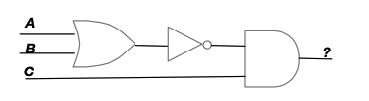
3-A
What is the boolean expression that corresponds to what the following logic circuit outputs? (Please write the expression with the most direct correspondence to this circuit without simplification.)
(bar(A+B))·C

Slide 74
3-B
Please simplify the boolean expression (A+B)·(A+B) according to the boolean logic laws in Appendix 6. Write down the detailed steps where each step applies only one law and name that law
Covered in Q2 of recitation 13

Slide 75
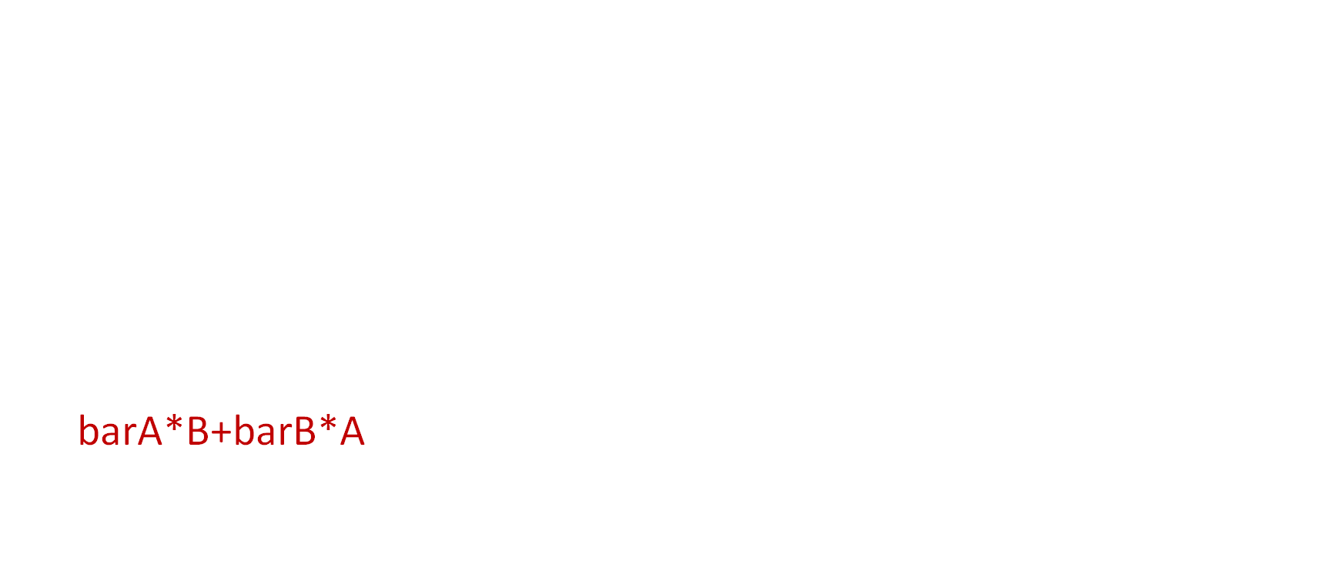
Q2 Simplify boolean expression
Simplify boolean expression (A+B) ⋅($\overline{A}$+ $\overline{B}$).
You may write `*` for ⋅, and write `barA` for $\overline{A}$ (or `barB` or $\overline{B}$)
(A+B)*(barA+barB)
=(A+B)*barA + (A+B)*barB
=barA*A + barA*B + barB*A + barB*B
=0+barA*B+barB*A+0
=barA*B+barB*A
Distribution law
Distribution law
Inverse law
Basic law

Slide 76
3-C
If we are to use a single logic gate to implement the simplified expression in B. Which gate to use?
AND
OR
NOR
NAND
XOR
None of the above

Slide 77
3-Question C. and D.
Question C. and D. ask you to implement a combinatorial circuit to compute a 3-input parity function. A parity function takes multiple 1-bit input signals and computes a 1-bit parity bit as the output. The parity bit is the sum of all input signals modulo 2. For example, if the 3 input signals are 110, the parity output is (1+1+0)%2 = 0. If the 3 input signals are 111, the parity output is (1+1+1)%2 = 1.

Slide 78
3-C
Please write the truth table for the 3-input parity function.
A | B | C | Output
0 | 0 | 0 | 0
0 | 0 | 1 | 1
0 | 1 | 0 | 1
0 | 1 | 1 | 0
1 | 0 | 0 | 1
1 | 0 | 1 | 0
1 | 1 | 0 | 0
1 | 1 | 1 | 1

Slide 79
3-D
Please draw the combinatorial circuit that implements the above parity function.
Follow the rule of “sum of products”
A | B | C | Output
0 | 0 | 0 | 0
0 | 0 | 1 | 1
0 | 1 | 0 | 1
0 | 1 | 1 | 0
1 | 0 | 0 | 1
1 | 0 | 1 | 0
1 | 1 | 0 | 0
1 | 1 | 1 | 1
Products
barA*barB*C
barA*B*barC
A*barB*barC
A*B*C

Slide 80
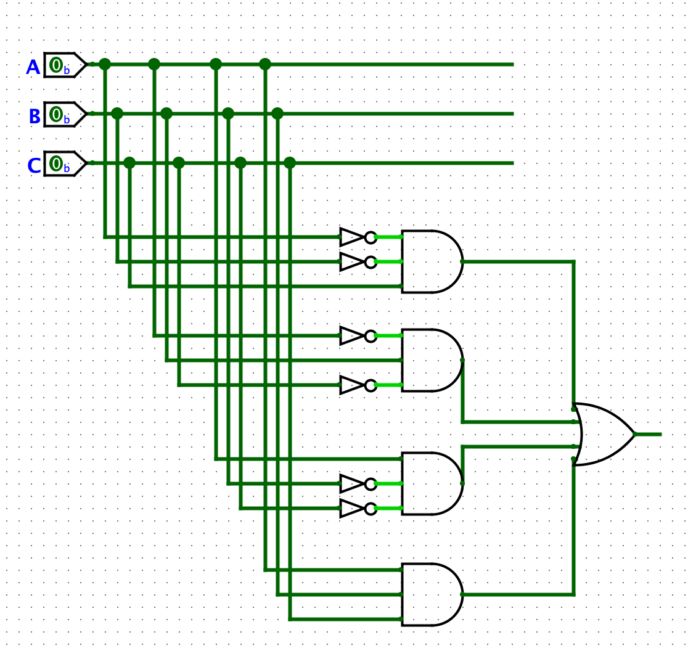
3-D
Please draw the combinatorial circuit that implements the above parity function.
barA*barB*C
barA*B*barC
A*barB*barC
A*B*C

Slide 81
4. CPU design
Figure 1 shows a basic single-cycle CPU design for RISC-V. The design handles 3 types of instructions: arithmetic instructions involving two source registers and one destination register, memory load instructions and store instructions. Note that the design does not implement conditional branches. Suppose the major logic blocks in Figure 1 have the following latencies (If a logic block’s latency is not specified, it is small enough to be ignored.)

Slide 82
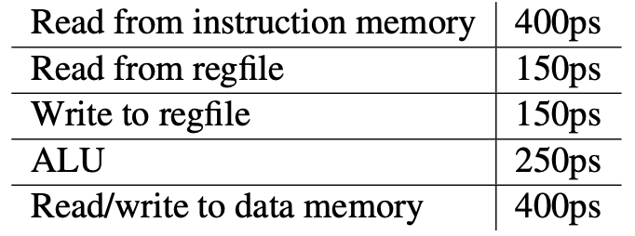
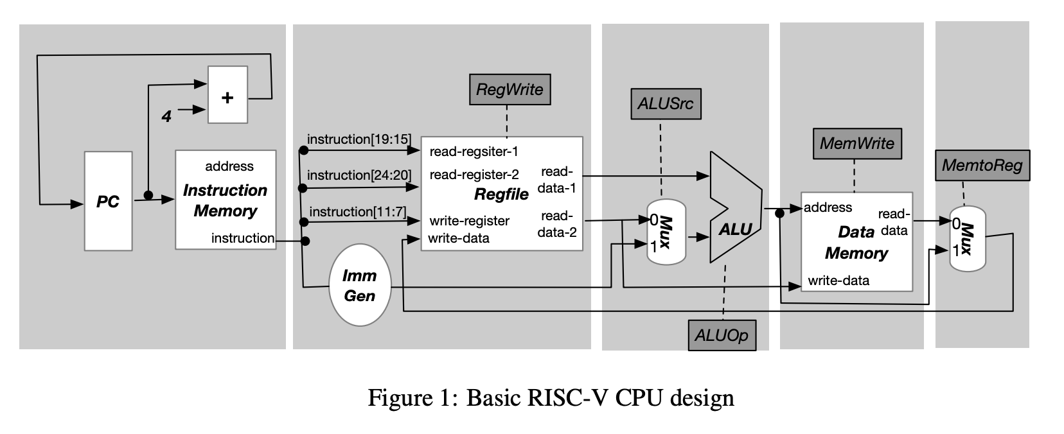
4. CPU design

Slide 83
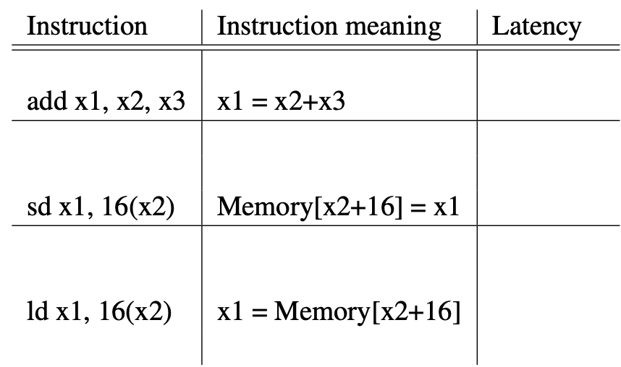
4-A
What is the minimum latency to execute each of the following instructions in the single-cycle design:

Slide 84
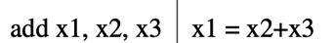
4-A
2
3
x2
400
1
150
x1
x3
250
150
x1
400+150+250+150=950

Slide 85
4-A
2
1
x2
400
150
x2+16
x1
250
400
16
16
400+150+250+400=1200

Slide 86
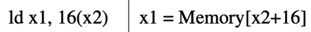
4-A
2
x2
400
150
x2+16
1
250
Mem[x2+16]
Mem[x2+16]
400
150
16
16
400+150+250+400+150=1350

Slide 87
4-B
What is fastest clock cycle time that can be used for the single-cycle CPU design?
The time sufficient for all instructions to finish
= time of slowest instruction
1350

Slide 88
4-C
Suppose we change the CPU in Figure 1 into 5-stage pipelined design: IF(instruction fetch), ID(instruction decode and register read), EX(execute operation or calculate address), MEM(memory access), WB(write back to regfile). The five stages of the pipeline are marked as the large grey rectangles in Figure 1. What is the fastest clock cycle time that can be used for the 5-stage design?
400ps
pipeline clock cycle=max_stage_time

Slide 89
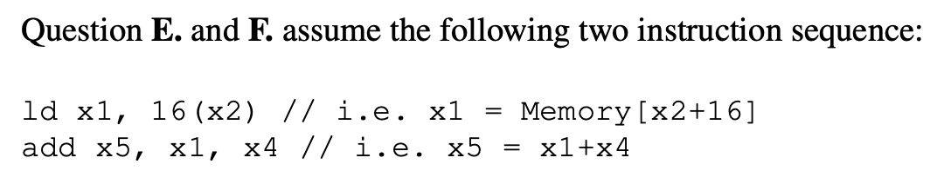
4-E
Suppose there is no forwarding between pipeline stages, how many bubbles (aka nop) must be inserted between the two instructions to ensure correctness?
2
i1 has just written x1 back
=> No hazard
i1: ld x1, 16(x2)
IF
ID
EX
MEM
WB
IF
ID
EX
MEM
bubble
When i2 tries to read x1
IF
ID
EX
bubble
IF
ID
i2: add x5, x1, x4

Slide 90
4-F
Suppose the result of MEM stage is forwarded to the EX stage, how many bubbles (aka nop) must be inserted between the two instructions to ensure correctness?
1
IF
ID
EX
MEM
x1
WB
i1: ld x1, 16(x2)
IF
ID
EX
MEM
bubble
IF
ID
EX
i2: add x5, x1, x4

Slide 91
Assessment 13

Slide 92
Q1 5-stage pipeline
This question assumes the 5-stage pipelined design of RISC-V (slide 21 of https://nyu-cso.github.io/notes/arch-cpu-pipeline.pdf), also reproduced here:

Slide 93
Q1.1
Consider the following sequence of RISC-V instructions.
How many clock cycles are needed to execute the above instruction sequence?
add x2, x1, x3 //x2=x1+x3
and x5, x1, x3 //x5 = x1 & x3
or x10, x11, x9 //x10 = x11 | x9
add x14, x1, x1 //x14 = x1+x1
add x15, x11, x12 //x15 = x11+x12

Slide 94
Q1.1
For n instructions with no hazards, #cycles = n+#stages-1 = n+4
More generally (considering hazards), #cycles = n+#stages-1+#bubbles
cycle 1
cycle 2
cycle 3
cycle 4
cycle 5
cycle 6
cycle 7
IF
ID
EX
MEM
WB
1 instruction needs 5 cycles
i1
2 need 6 cycles
i2
IF
ID
EX
MEM
WB
IF
ID
EX
MEM
WB
3 need 7 cycles
i3
Q1.1 has no hazards; it has 5(n) instructions, so answer is 5+4=9

Slide 95
Q1.2
Consider a different sequence of instructions:
How many clock cycles are needed to execute the above instruction sequence? We assume the pipeline does not perform forwarding but only relies on stalls (aka inserting bubbles) to handle hazard. We also assume that one can read the data written to the register in the same cycle.
add x2, x1, x3 //x2=x1+x3
and x5, x2, x3 //x5 = x2 & x3
or x10, x2, x9 //x10 = x2 | x9
add x14, x2, x2 //x14 = x2+x2
add x15, x2, x12 //x15 = x2+x12

Slide 96
Q1.2
add x2, x1, x3 //x2=x1+x3
and x5, x2, x3 //x5 = x2 & x3
or x10, x2, x9 //x10 = x2 | x9
add x14, x2, x2 //x14 = x2+x2
add x15, x2, x12 //x15 = x2+x12
Answer= n+#stages-1+#bubbles
Are there any hazards?
How many bubbles introduced by the hazard?
x2 is not written back until here
i1: add x2, x1, x3
IF
ID
EX
MEM
WB
i2: and x5, x2, x3
IF
ID
EX
MEM
IF
ID
EX
i3: or x10, x2, x9
x2 needs to be read here
x2 needs to be read here

Slide 97
Q1.2
add x2, x1, x3 //x2=x1+x3
and x5, x2, x3 //x5 = x2 & x3
or x10, x2, x9 //x10 = x2 | x9
add x14, x2, x2 //x14 = x2+x2
add x15, x2, x12 //x15 = x2+x12
Answer= n+#stages-1+#bubbles
Are there any hazards?
How many bubbles introduced by the hazard?
2
No hazards afterwards
answer=9+2=11
i1
IF
ID
EX
MEM
WB
IF
ID
EX
MEM
bubble
IF
ID
EX
bubble
IF
ID
i2
IF
ID
i3

Slide 98
Q1.3
ld x2, 100(x1) //x2=Memory[100+x1]
and x5, x2, x3 //x5 = x2 & x3
or x10, x2, x9 //x10 = x2 | x9
add x14, x2, x2 //x14 = x2+x2
add x15, x2, x12 //x15 = x2+x12
Consider yet another sequence of instructions:
How many clock cycles are needed to execute the above instruction sequence? Like before, we assume the pipeline does not perform forwarding but only relies on stalls (aka inserting bubbles) to handle hazard. We also assume that one can read the data written to the register in the same cycle.
same as previous question: need to postpone i2’s ID until i1’s WB’s cycle
11

Slide 99
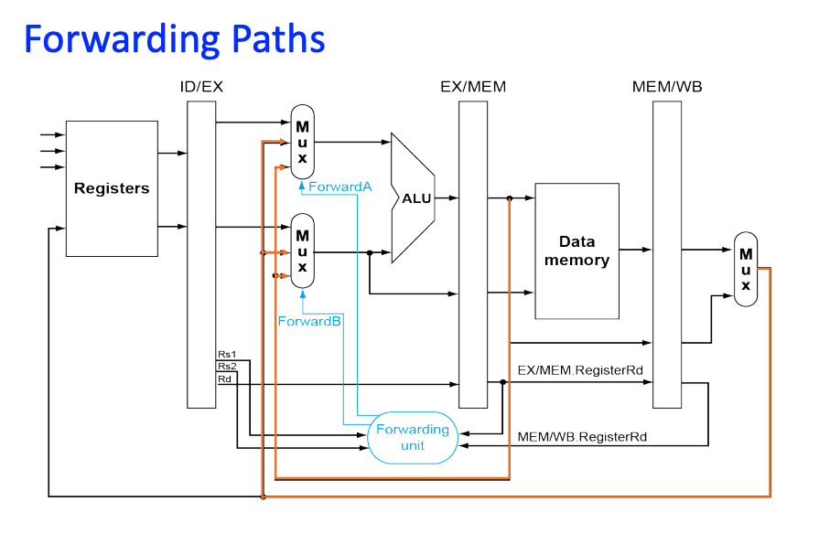
Q1.4
add x2, x1, x3 //x2=x1+x3
and x5, x2, x3 //x5 = x2 & x3
or x10, x2, x9 //x10 = x2 | x9
add x14, x2, x2 //x14 = x2+x2
add x15, x2, x12 //x15 = x2+x12
Suppose the CPU performs forwarding, as done on slide 34 of https://nyu-cso.github.io/notes/arch-cpu-pipeline.pdf
How many clock cycles are needed to execute the instruction sequence in Q1.2?

Slide 100
Q1.4
add x2, x1, x3 //x2=x1+x3
and x5, x2, x3 //x5 = x2 & x3
or x10, x2, x9 //x10 = x2 | x9
add x14, x2, x2 //x14 = x2+x2
add x15, x2, x12 //x15 = x2+x12
Answer= n+#stages-1+#bubbles
IF
ID
EX
x2
MEM
x2
WB
i1
IF
ID
EX
MEM
i2
IF
ID
EX
i3
No bubbles
Answer=n+4=9

Slide 101
Q1.5
ld x2, 100(x1) //x2=Memory[100+x1]
and x5, x2, x3 //x5 = x2 & x3
or x10, x2, x9 //x10 = x2 | x9
add x14, x2, x2 //x14 = x2+x2
add x15, x2, x12 //x15 = x2+x12
Suppose the CPU performs forwarding, how many clock cycles are needed to execute the instruction sequence in Q1.3?
Answer= n+#stages-1+#bubbles
x2 is not ready until here
i1: ld x2, 100(x1)
IF
ID
EX
MEM
WB
i2: and x5, x2, x3
IF
ID
EX
MEM
IF
ID
EX
i3: or x10, x2, x9
Forwarding postpone x2’s dependency to here, but not still too late

Slide 102
Q1.5
ld x2, 100(x1) //x2=Memory[100+x1]
and x5, x2, x3 //x5 = x2 & x3
or x10, x2, x9 //x10 = x2 | x9
add x14, x2, x2 //x14 = x2+x2
add x15, x2, x12 //x15 = x2+x12
Suppose the CPU performs forwarding, how many clock cycles are needed to execute the instruction sequence in Q1.3?
Answer= n+#stages-1+#bubbles
i1: ld x2, 100(x1)
IF
ID
EX
MEM
x2
WB
bubble
IF
ID
EX
MEM
IF
ID
EX
i2: and x5, x2, x3
1 bubble
Answer=n+4+1=10
IF
ID
EX
i3: or x10, x2, x9

Slide 103
Q2 4-stage pipeline
Ben Bitdiddle decides to make a 4-stage pipelined CPU by merging the IF and ID stage of the 5-stage pipeline into a combined IFID stage, as shown below.

Slide 104
Q2.1
add x2, x1, x3 //x2=x1+x3
and x5, x1, x3 //x5 = x1 & x3
or x10, x11, x9 //x10 = x11 | x9
add x14, x1, x1 //x14 = x1+x1
add x15, x11, x12 //x15 = x11+x12
For the instruction sequence in Q1.1, how many clock cycles are needed to execute them all? (We assume Ben sets the clock frequency appropriately so that each stage can be completed in one clock cycle)
8
#cycles = n+#stages-1+#bubbles
#bubbles=0
#stages=4
answer=8

Slide 105
Q2.2
 | IF | ID | EX | MEM | WB | max
old | x | x | x | x | x | x
new | 2x |  |  |  |  | 2x
Assuming in the original 5-stage design, each stage takes exactly the same amount of time to execute. Which of the following statements are true for Ben's 4-stage pipeline design?
Under the new 4-stage design, the clock period can remain the same as that in the 5-stage design.
Under the new 4-stage design, the clock period is twice as long as that in the 5-stage design.
It takes longer time to execute the instruction sequence of Q1.1 under the 4-stage design than the original 5-stage design.
It takes shorter time to execute the instruction sequence of Q1.1 under the 4-stage design than the original 5-stage design.
It takes the same amount of time to execute the instruction sequence of Q1.1 under the 4-stage design than the original 5-stage design.
clock period=max_stage_time
 | cycles | clock period | time
old | 9 | x | 9x
new | 8 | 2x | 16x

Slide 106
Q3 Another 4-stage design
Ben Bitdiddle tries another a 4-stage pipelined design. This time, he combines EX and MEM stage into a single stage EXMEM, as shown below.
To make this new design possible, Ben modifies the RISC-V instruction set so that the load and store instructions no longer take an offset. Rather, the member address must be calculated explicitly through an arithmetic instruction and stored in some register before load and store.

Slide 108
Q3.1
In the instruction sequence of Q1.3, the first instruction is ld x2, 100(x1), which is not supported by Ben's new ISA. Please write an equivalent RISC-V instruction sequence that's supported by Ben's ISA while achieving the same desired effect.
addi x1, x1, 100
ld x2, x1

Slide 109
Q3.2
addi x1, x1, 100
ld x2, x1
and x5, x2, x3 //x5 = x2 & x3
or x10, x2, x9 //x10 = x2 | x9
add x14, x2, x2 //x14 = x2+x2
add x15, x2, x12 //x15 = x2+x12
How many clock cycles are needed to execute the instruction sequence of Q1.3 under Ben's new 4-stage CPU design?
We assume no forwarding.
We assume the instruction ld x2, 100(x1) is substituted with your answer in Q3.1.

Slide 110
Q3.2
addi x1, x1, 100
ld x2, x1
and x5, x2, x3 //x5 = x2 & x3
or x10, x2, x9 //x10 = x2 | x9
add x14, x2, x2 //x14 = x2+x2
add x15, x2, x12 //x15 = x2+x12
Answer= n+#stages-1+#bubbles
Are there any hazards?
Postpone i2 and i3 by 1 cycle each.
#bubbles = 2
Answer=6+4-1+2=11
x1 is not written back until here
i1: addi x1, x1, 100
IF
ID
EXMEM
WB
x2 is not written back until here
x1 needs to be read here
i2: ld x2, x1
IF
ID
EXMEM
WB
IF
ID
EXMEM
i3: or x10, x2, x9
x2 needs to be read here

Slide 111
Q3.3
Merge
 | IF | ID | EX | MEM | WB | max
old | x | x | x | x | x | x
new |  |  | max(x,x)=x
EX
IF
ID
WB
MEM
Assuming in the original 5-stage design, each stage takes exactly the same amount of time to execute. Which of the following statements are true about Ben's new 4-stage pipeline design?
Under this 4-stage design, the clock period can remain the same as that in the 5-stage design.
Under this 4-stage design, the clock period is twice as long as that in the 5-stage design.
It takes longer time to execute the instruction sequence of Q1.1 under this 4-stage design than the original 5-stage design.
It takes shorter time to execute the instruction sequence of Q1.1 under this 4-stage design than the original 5-stage design.
It takes the same amount of time to execute the instruction sequence of Q1.1 under this 4-stage design than the original 5-stage design.
Since only one of EX or MEM used for each instruction
 | cycles | clock period | time
old | 9 | x | 9x
new | 8 | x | 8x

